Slide 1




Slide 2

SKILLS INTROSPECTION

Slide 3

SKILLS INTROSPECTION
Identify Your USP

Slide 4
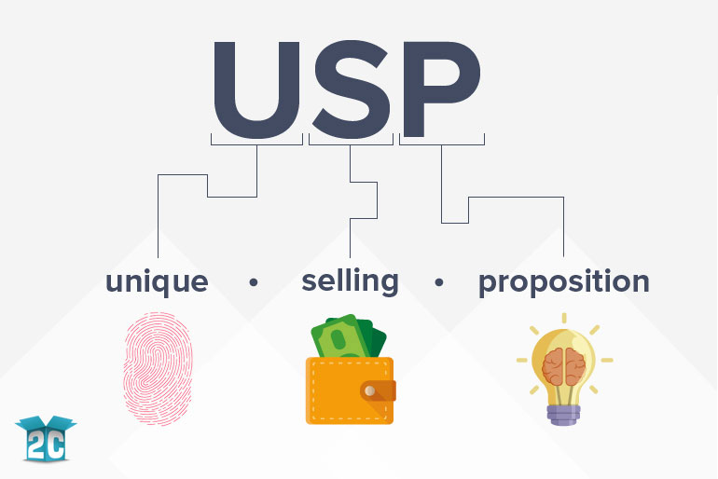
SKILLS INTROSPECTION
What is USP?

Slide 5

SKILLS INTROSPECTION
Importance of Unique Selling Point
Notes:
UNIQUE SELLING POINT – IMPORTANCE
A unique selling point defines your company’s unique position in the marketplace, getting at the heart of your business: the value you offer and the problem you solve. A strong USP clearly articulates a specific benefit – one that other competitors don’t offer – that makes you stand out. If all the products appear to be the same, your prospective customers won’t know which one is right for them. Being clear about your unique selling proposition helps them differentiate between the variety of choices available to them. It is a crucial part of effective selling, especially online where consumers have so many options. A USP can also serve an important role internally as it forces you to consider your company’s mission and its very reason for being.
As a business owner, you need to consider and communicate who your business is for, what drives you to offer the services you offer, and how you want to make a unique impact. Your USP is your key differentiator and the reason your customer will buy from you.

Slide 6

SKILLS INTROSPECTION
Unique Selling Point Examples
Notes:
UNIQUE SELLING POINT EXAMPLES
Zappos is an online shoe store, and there is nothing especially unique about selling shoes online. However, their selling point is unique: free returns. There is no penalty whatsoever to returning a pair of shoes you don’t want, a major convenience to customers. Toms Shoes is a shoe manufacturer. Again, there is nothing especially unique about that. But Toms Shoes’ unique selling point is that for every pair of shoes a customer purchases, the company donates a pair to a child in need. Toms Shoes helps put shoes on needy children’s feet; this is their unique selling point. USPs are by their nature unique to each business, but roughly fall into two major categories:
• Quality: Superior materials or ingredients, superior craftsmanship, proprietary manufacturing methods, one of a kind
• Price: The lowest price guaranteed, price matching, free shipping, bulk discounts, special offers
For established companies, the USP can eventually become synonymous with their brand, to where when the company’s name is automatically associated with the unique value proposition that the brand offers.

Slide 7
SKILLS INTROSPECTION
Steps to Determine Your Unique Selling Point
List the features and benefits that are unique
Decide what emotional need is being specifically met by your product
Identify aspects of your product or service
Create phrases that are short, clear, and concise
Answering your customer's primary question
Notes:
STEPS TO DETERMINE YOUR UNIQUE SELLING POINT
A unique selling point (USP), also called a unique selling proposition, is the essence of what makes your product or service better than competitors. In online marketing, communicating your USP clearly and quickly is one of the keys to getting customers to convert on your site.
Steps to determine unique selling point are as follows:
1. List the features and benefits that are unique about your product or service: Do a Google search and compare your features and benefits with your direct competitors. Identify the benefits what sets you apart.
2. Decide what emotional need is being specifically met by your product or service: Think about this from your customer's perspective and add it to your list.

Slide 8
SKILLS INTROSPECTION
Steps to Create a Unique Selling Proposition
Describe Your Target Audience
Explain the Problem You Solve
List the Biggest Distinctive Benefits
Define Your Promise
Combine and Rework
Cut it Down
Notes:
STEPS TO CREATE A UNIQUE SELLING PROPOSITION
The Unique Selling Proposition (USP for short) is what sets your products and/or services apart from your competitors. Expressed as a single sentence that summarizes the essence of your business, the Unique Selling Proposition serves as the theme of your marketing
Step 1: Describe Your Target Audience
Before you can even start marketing your services, you need to know who you are targeting. In this step, you want to be as specific as possible. For example, if you are a Web developer with a CMS expertise, instead of targeting anyone who needs helping to build or modifying a CMS, you may identify your target client as a small business owner who is looking for a developer well-versed to customize his/her site.
Step 2: Explain the Problem You Solve
From your prospective clients’ perspective, what is the individual need or challenge they face that your business can solve for them?
Step 3: List the Biggest Distinctive Benefits
In this step, list 3-5 of the biggest benefits a client gets from choosing to work with you that they could not get from someone else (i.e., what sets you apart from your competition). Again, thinking from the clients’ perspective, these benefits should explain why your services are important to them and why they would choose you over another provider.
Step 4: Define Your Promise
A big part of a successful USP is making a pledge to your clients. While this can be implied instead of spelled out in your USP, write down this promise you make to your clients in this step.
Step 5: Combine and Rework
Once you’ve completed steps 1-4, take all the information you listed and combine it into one paragraph. There should be some recurring ideas and thoughts, so you’ll want to start merging statements and rewriting in a way that flows and makes sense.
Step 6: Cut it Down
In this step, take your paragraph from step 5 and condense it even more into just a sentence. You want your final USP to be as specific and simple as possible. Take your time while doing this exercise and do several drafts over the course of a week until you arrive at your final USP. A fresh mind and perspective is essential, so I would recommend doing this at the beginning of your day versus at the end when you are tired. You also may want to come back and do this exercise again, once you try out your USP for a while, or if anything changes with your business.

Slide 9
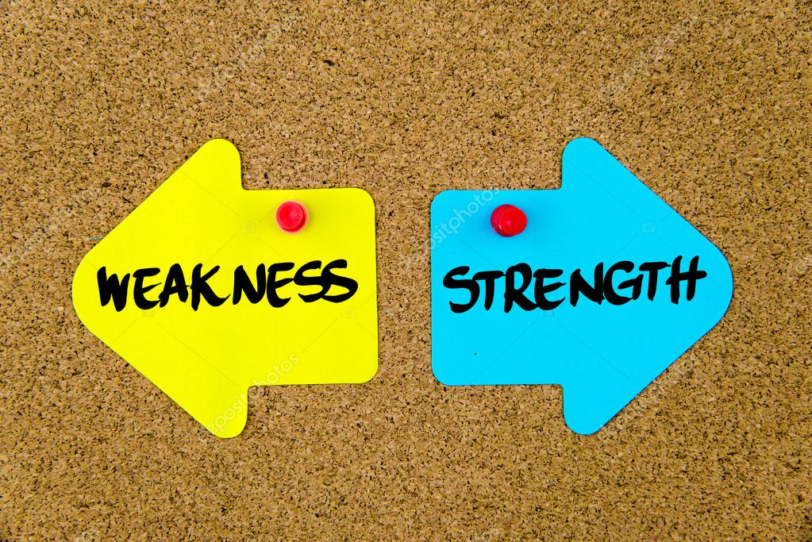
SKILLS INTROSPECTION
Recognize Your Strengths And Weaknesses
Notes:
This is the template for slides with only an image

Slide 10

SKILLS INTROSPECTION
What is Strengths And Weakness ?
Notes:
STRENGTHS AND WEAKNESS – WHAT IS IT?
Strengths and weaknesses generally refer to a person's character. Strength is the ability to consistently provide near-perfect performance in a specific activity. The key to building a strength is to identify your dominant talents, then complement them by acquiring knowledge and skills pertinent to the activity.
Weakness is a flaw or fault or defect in an individual. This always acts as a hurdle in achievement, because of lack of respective talent. Often a strength can be a weakness, and vice versa, a weakness can be a strength. Strengths and weaknesses generally refer to a person's character. Strength is the ability to consistently provide near- perfect performance in a specific activity. Weakness is a flaw or fault or defect in an individual. Knowing your own strengths and weaknesses gives you a better understanding of yourself

Slide 11
SKILLS INTROSPECTION
Benefits of Knowing Strengths And Weaknesses
Understanding Your Abilities
Performing a Reflexive Best Self Exercise
Listing Your Actions
Listing Your Desires
Notes:
BENEFITS OF KNOWING STRENGTHS AND WEAKNESS
Your biggest personal strength would be something that comes very easily for you. Your weaknesses hold you back from achieving many great things. Weaknesses are areas that you have the power to improve. It can be anything ranging from professional to social skills. Knowing the strengths and weakness allows one to understand the necessary changes that is required in self- improvement.
Understanding Your Abilities
Step 1: Appreciate your effort
Step 2: Write down what you do
Step 3: Reflect on your values
Step 4: Examine your responses for themes and patterns.
Step 5: Determine whether your life aligns with your values
Step 6: Consider situational meanings.
Performing a Reflexive Best Self Exercise
Step 1: Find people to ask.
Step 2: Ask for feedback
Step 3: Look for commonalities.
Step 4: Make a self-portrait.
Listing Your Actions
Step 1: Write about your actions.
Step 2: Think of a challenging situation in which something bad happened.
Step 3: Find a less challenging situation
Step 4: Consider times you faced a difficult personal situation
Listing Your Desires
Step 1: Ask yourself about your desires.
Step 2: Decide what you enjoy
Step 3: Consider what motivates you.

Slide 12
SKILLS INTROSPECTION
How to Assess Strengths And Weaknesses ?
Rethink your weaknesses
Identify your areas for growth
Focus on your strengths
Write down your strengths and weaknesses
Compare the lists against one another
Notes:
HOW TO ASSESS STRENGTHS AND WEAKNESSES?
Accessing your personal strengths and weaknesses can help you a lot in choosing the right career or making good decisions. because if you can focus what you do around your personal strengths, you have the chance to create something remarkable, while making it look like it's almost effortless.
There are few ways to assess strengths and weaknesses. They are:
• Rethink your weaknesses
"Weakness" isn't the most helpful way to think about areas for development. People really aren’t weak, even though we might really feel or think this way at times. However, most people feel that they could be stronger in certain areas in their lives, their skill sets, and other areas. Since they feel they are not as strong in those areas, it’s common to assign the opposite to describe when we feel we need to work on an area to feel stronger and competent. Instead of focusing on "weakness," which has a negative feel to it, think about your areas for growth or improvement -- this keeps you focused on the future and what you can do to get better.
• Identify your areas for growth
Areas in which you can develop might be related to anything, including certain professional or social skills or poor self- restraint with food. You could also simply refer to an inability to catch a baseball or perform math equations quickly. Oftentimes, areas for growth are framed in terms of "learning lessons from life" and not repeating mistakes.
• Focus on your strengths
Some might consider focusing on personal weaknesses at all as waste of time, or even a mis-framing of the issues. Instead, focus primarily on your strengths and try to cultivate these whenever possible. This can be a better approach then identifying personal weaknesses.
• Write down your strengths and weaknesses
Once you assess all you've written down about your actions and desires, it's time to focus on what you think your strengths and weaknesses are. Using the lists from other people you got earlier and that what you have learned about yourself through the other exercises, write down areas of your work and life that you think are your strong and weak areas.
• Compare the lists against one another
Did they match up and did you find any surprises? Did you think you were strong in one area but in your actions list that doesn’t appear to be the case? This type of mismatch occurs when you're telling yourself you're one way, but a challenging situation displays your real character instead.

Slide 13
SKILLS INTROSPECTION
How to Assess Strengths And Weaknesses ?
Ask the opinions of friends or family
Seek professional assistance
Reflect on your findings
Reject perfectionism
Don't deny important moments in your life
Notes:
HOW TO ASSESS STRENGTHS AND WEAKNESSES?
• Ask the opinions of friends or family
Have a close friend or family member provide you with constructive feedback. Although self-examination can lead you to a few answers, getting an outside opinion will help you either solidify your observations or can shatter a few illusions as well. Learning how to receive constructive feedback from others is essential to being part of a community.
• Seek professional assistance
If you are still having trouble, or would feel more comfortable with an outside source, ask a professional to help you to determine your strengths and weaknesses.
• Reflect on your findings
After you assess your strengths and weaknesses, spend some time to reflect and determine how you feel about what you found. Decide if you need or want to work on any of your weaknesses and contemplate what you will need to do to attack or change these weaknesses.
• Reject perfectionism
Take care not to become hung up on your weaknesses. This pattern can quickly fall into the nonconstructive pattern of perfectionism, which can hold you back from success. It’s better to begin with what you do well for a given skill set, then find several details to enhance those skills and slowly improve over time.
• Don't deny important moments in your life
Everyone has things in their life that they excel at. There are times when you do something you've never done before, but it just clicks, and you find that you're a total natural at it.

Slide 14

SKILLS INTROSPECTION
Nurture Strengths And Fixing Weakness
Notes:
This is the template for slides with only an image

Slide 15
SKILLS INTROSPECTION
Stages of Strength And Talent Development
Inviting and invoking
Identifying and clarifying the strength or talent
Claiming and receiving the strength or talent
Honouring and practicing the strength or talent
Offering our strength or talent to the world
Notes:
STAGES OF STRENGTH AND TALENT DEVELOPMENT
It’s surprisingly difficult for many people to talk about their strengths. It’s challenging to balance your humility with the need to project confidence. As with weaknesses, you can generally choose between skills/habits and personality traits. These five stages of strength and talent development can help us see how we can cultivate our strengths and talents:
1. Inviting and invoking: Ask for a strength or talent we value, seek it through writing or visual arts.
2. Identifying and clarifying the strength or talent: Name the strength or talent, for example, “creative problem solver” and then describe how that strength or talent is used in our lives.
3. Claiming and receiving the strength or talent: Acknowledge to self and others that we possess this strength or talent and accept it as part of who we are.
4. Honouring and practicing the strength or talent: We exercise the strength or talent to improve and strengthen it.
5. Offering our strength or talent to the world: We find a place where our strength or talent is needed by the world, and where it can be nurtured and grow.

Slide 16

SKILLS INTROSPECTION
When Should You Focus on Your Strengths?
Notes:
WHEN SHOULD YOU FOCUS ON YOUR STRENGTHS?
If you understand the logic behind following your strengths, you can also more easily see where it doesn’t apply. It’s not a complicated analysis either.
You should focus on your strengths, and ignore your weaknesses, whenever:
• The weakness is not a requirement.
• You can outsource the weakness to someone else

Slide 17

SKILLS INTROSPECTION
When Should You Focus on Your Strengths?
Notes:
PROMPTS TO HELP YOU DEVELOP STRENGTHS AND TALENTS
1. What are your strengths and talents?
2. What strength or talent is ready to emerge, evolve or resurface?
3. How have you denied or hidden any strength/talent in the past?
4. How is your life and others’ lives impacted when you withhold your strength/talent?
5. What might be living in this strength/talent look like?
6. What support from others do you need to develop your strength/talent?
7. What does your strength/talent need from you?

Slide 18

SKILLS INTROSPECTION
Tips for Nurturing Strengths And Fixing Weaknesses
Notes:
TIPS FOR NURTURING STRENGTHS AND FIXING WEAKNESSES:
• Be careful when identifying your desires that you don't add false desires.
• Changing weaknesses takes time, so give yourself a break if you can’t make immediate resolutions.
• In an interview situation, never boast about your strengths or whine about your weaknesses. Be straight forward and suggest way to work around your alleged weakness.
• Avoid falling into the trap of thinking that unless you're all strengths and no weaknesses, that you're doomed.
• Versatility, Trustworthiness, and Determination will add value to your job interviews
• Building confidence, recognizing weaknesses, and Focusing on positive will apply to improve all weaknesses
• Having more knowledge, authenticity, and books is considered as a strength for a student

Slide 19

SKILLS INTROSPECTION
Overcoming Your Complex
Notes:
This is the template for slides with only an image

Slide 20
SKILLS INTROSPECTION
Ways to Overcome Your Complex in a Team
Your Leader Is the Weak Link
Personal Conflicts Are Taking Over
Only a Few Carry the Team's Load
Self-Interest Is the Name of the Game
Notes:
WAYS TO OVERCOME YOUR COMPLEX IN A TEAM
There are many ways on can overcome complex in a team. Here are the most common ways in which a team can fail, along with practical tips for turning problems into solutions.
• Your Leader Is the Weak Link
Ideally, a leader is the person who points the team in the right direction. Sometimes, though, a leader just isn't up to the job. In that case, says Zachary Green, senior scholar at the University of Maryland's Burns Academy of Leadership, "people with informal authority need to take up the slack." But isn't that insubordination? Not if you behave appropriately.
One's first allegiance should not be to the immediate superior, but to the organization's mission. If a leader has weaknesses that undermine your team's effectiveness, it is not only your right, but also your responsibility, to compensate for those weaknesses with your own strengths. This doesn't mean that you sit around all day plotting the overthrow of your boss. Rather, ask yourself how you can best serve your leader and organization, and then follow through.
• Personal Conflicts Are Taking Over
From time to time, it's inevitable that personal issues will get in the way of teamwork. For instance, if John and Sue have a big fight, it's likely they'll shoot each other's ideas down, no matter how good they happen to be. "This is all about ego needs and has nothing to do with the work that needs to get done," Green says. This must be addressed and dealt with, or else John and Sue need to leave the team.
• Only a Few Carry the Team's Load
Sometimes it's easier just to hang back and let the team's real go-getters take over. The problem with this scenario is that no one or two people can carry the entire team's workload for long. Sooner or later, the shining stars will get a clue about what's going on and will stop killing themselves to get the work done -- and the entire team will go down as a result. "Some people get a sense of gratification from being needed all the time," Green says. "But obviously, one person can't meet everyone's needs.
• Self-Interest Is the Name of the Game
Who hasn't encountered the colleague who's always on the lookout for number one? Often, the problem is more complex than one difficult employee. On a team, Green says, this problem is likely to build critical mass, until several people are bucking for a promotion, often at the expense of everyone else. "They withhold information from the team and then catch the boss alone," he says. "What happens is that the team's fibre of trust gets eroded."
Sometimes, all you need to do is open a dialogue with the people who are disrupting the team. If that doesn't work, they'll simply have to leave. Jim Jose, an organizational effectiveness strategist and leadership coach based in Tucson, remembers a member of a team he was leading whose self-serving behaviour was wreaking havoc on everyone else. "I called her on it," he recalls. "I told her, 'Here's the standard I expect, here's the standard your teammates expect, and if you can't operate on that level, you'll have to leave.'

Slide 21

SKILLS INTROSPECTION
Confidence Building
Notes:
This is the template for slides with only an image

Slide 22

SKILLS INTROSPECTION
What is Confidence ?
Notes:
CONFIDENCE – WHAT IS IT?
Confidence has a common meaning of a certainty about handling something, such as work, family, social events, or relationships. Some have ascribed confidence as a state of being certain either that a hypothesis or prediction is correct or that a chosen course of action is the best or most effective. Self- confidence is having confidence in one's self.
Arrogance or hubris in this comparison is having unmerited confidence – believing something or someone is capable or correct when they are not. Overconfidence or presumptuousness is excessive belief in someone (or something) succeeding, without any regard for failure. Confidence can be a self-fulfilling prophecy as those without it may fail or not try because they lack it and those with it may succeed because they have it rather than because of an innate ability.

Slide 23
SKILLS INTROSPECTION
Ways to Improve Confidence
Planning and Preparation
Learning, Knowledge and Training
Notes:
WAYS TO IMPROVE CONFIDENCE
• Planning and Preparation
People often feel less confident about new or potentially difficult situations. Perhaps the most important factor in developing confidence is planning and preparing for the unknown.
If you are applying for a new job for example, you would be wise to prepare for the interview. Plan what you would want to say in the interview and think about some of the questions that you may be asked. Practise your answers with friends or colleagues and gain their feedback.
• Learning, Knowledge and Training
Learning and research can help us to feel more confident about our ability to handle situations, roles and tasks.
Knowing what to expect and how and why things are done will add to your awareness and usually make you feel more prepared and ultimately more confident. Learning and gaining knowledge can sometimes make us feel less confident about our abilities to perform roles and tasks, when this happens we need to combine our knowledge with experience. By doing something we have learned a lot about we put theory to practice which develops confidence and adds to the learning and comprehension.

Slide 24
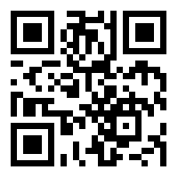
https://learn.codemithra.com

Slide 25




THANK YOU
+91 78150 95095
codemithra@ethnus.com
www.codemithra.com

